Slide 1



Front End Engineering
SNAPSHOT GALLERY
PRESENTED BY :
TRAINER :
Rehmat Papneja
Mr. Rishik

Slide 2



INTRODUCTION
The Snapshot Gallery, built with React, offers seamless image management and display. It features dynamic image addition/removal and an optional dark mode for enhanced user experience..

Slide 3


USER-CENTRIC DESIGN
Ensuring an intuitive interface with easy navigation and content management, prioritizing the user's experience and convenience.
OBJECTIVES AND GOALS
DYNAMIC IMAGE MANAGEMENT
Enabling users to add and remove images effortlessly, providing flexibility and customization for their unique galleries.
ENHANCED VISIBILITY WITH DARK MODE
Offering users the option to switch to a dark mode theme, improving visibility and providing a visually appealing alternative.

Slide 4






TECHNOLOGIES USED
Here are the technologies I have used in my project-
React
JavaScript and JSX
A powerful JavaScript library for building user interfaces, enabling the creation of reusable UI components.
The core programming languages for developing interactive elements, enhancing user interactions.
CSS
HTML
Applied for visual styling, ensuring an aesthetically pleasing and responsive layout.
Provides the structural foundation for component organization, enhancing accessibility and SEO.

Slide 5
App Component
DarkModeToggle
PROJECT STRUCTURE
Gallery
AddImage
Here is the mind map and the basic structure of my project-
Image
LoadingState
ImageUploadValidation
RemoveImage

Slide 6
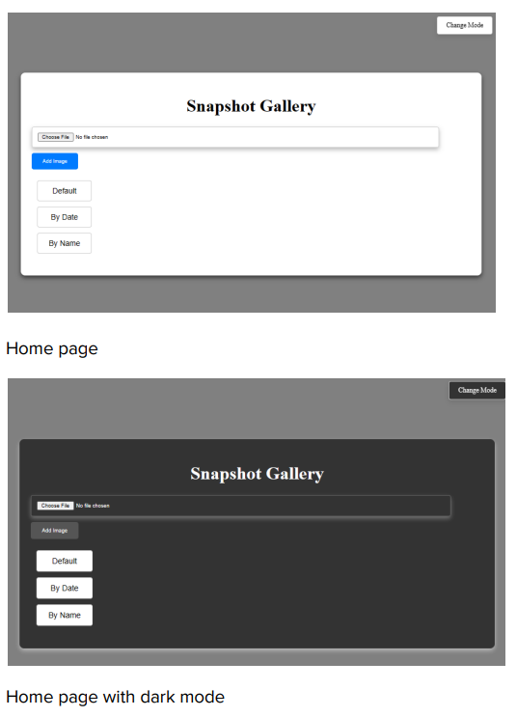


DARK MODE AND UI/UX DESIGN
The application boasts a Dark Mode feature, allowing users to customize their viewing experience. This feature not only enhances aesthetics but also improves visibility, particularly in low-light environments. Additionally, the user interface and experience have been meticulously designed. Intuitive navigation, responsiveness across devices, a minimalistic layout, and accessibility features have all been prioritized to ensure a seamless and user-friendly interaction.

Slide 7

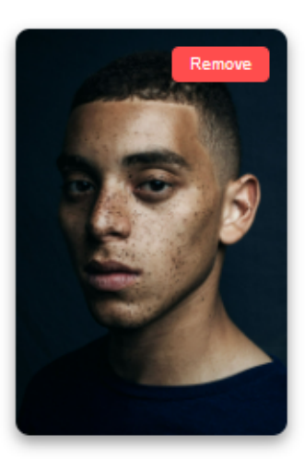
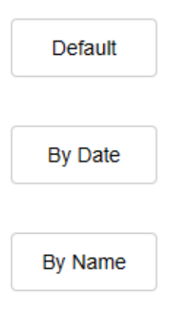
IMAGE GALLERY FUNCTIONALITIES
Dynamic image addition: Users can seamlessly add images to their galleries, enhancing personalization and content management.
2. Effortless Removal: Intuitive 'Remove' buttons allow users to easily remove specific images, providing control over their content.
3. Sorting Options: Users have the flexibility to sort images by date or name, ensuring a customized viewing experience.

Slide 8


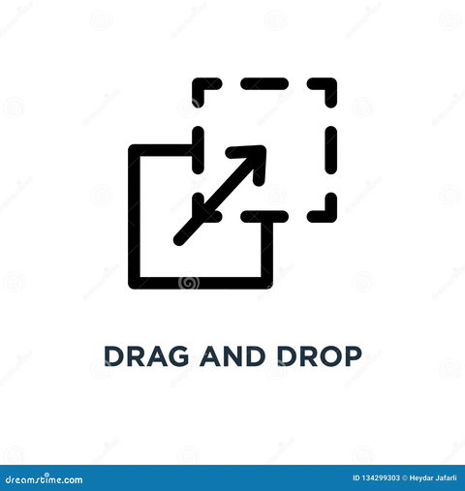
ENGAGING USER EXPERIENCE
The application ensures seamless interaction through intuitive features and responsive design. Users effortlessly navigate, add or remove images, and customize with Dark Mode. The drag-and-drop functionality simplifies image addition.

Slide 9

CONCLUSION
T
he Snapshot Gallery project showcases seamless integration of cutting-edge technologies. User-centric design principles ensure an intuitive experience. Dynamic image management and Dark Mode exemplify versatility. Future endeavors include user feedback-driven refinements and potential feature expansions. Gratitude to the community and mentors for invaluable support.

Slide 10

FUTURE IMPOVEMENTS
Potential improvements that I can do in my project are:
Advanced Sorting Options
User Accounts and Authentication
Social Media Integration
Collaborative Galleries
Implement filters based on tags, categories, or user-defined criteria for enhanced organization.
Allow users to share images directly to their social media platforms.
Facilitate shared galleries for group projects or events
Enable user accounts for personalized galleries and secure authentication.

